Slide 1
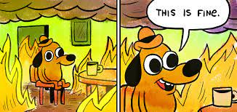
Internship for Final Examination and Study Plan
A handy guide to handle all of this!

Slide 2
PREMISE!
You don’t have to understand EVERYTHING present on this powerpoint presentation!
If you need anything SCoRe Staff is ALWAYS here to answer to your questions ☺

Slide 3
Procedure
Step 3
Step 2 - Asking yourself:
Step 4
Study Plan
Internal/External Internship ?
With scholarship ?
Ciamician/Erasmus
F.Flaminia
Step 1
What do you like?
Whom can you ask to?
Where do you want to do it?
With or without scolarship?

Slide 4
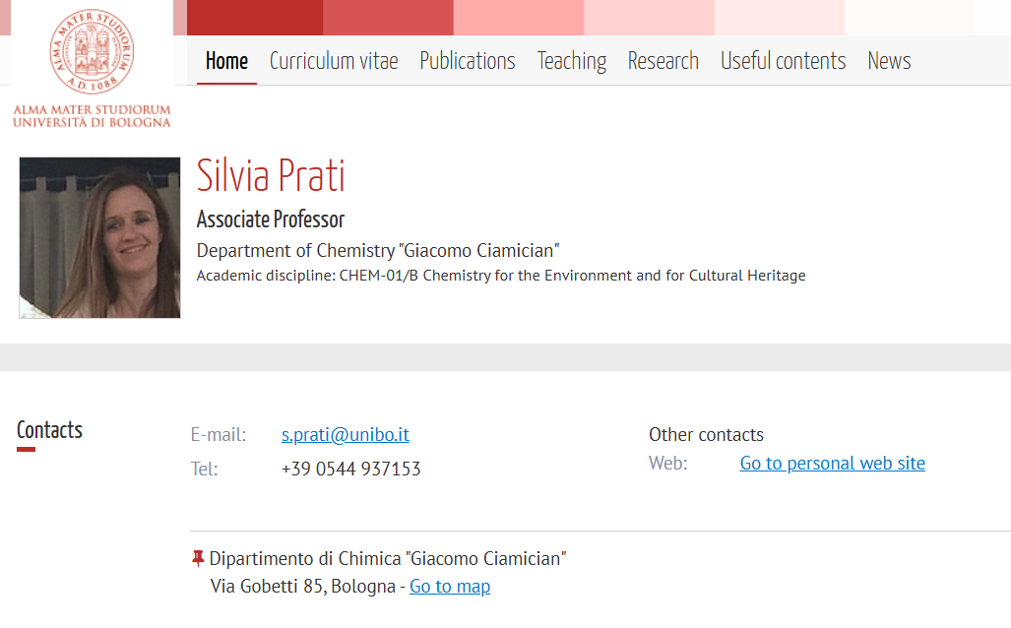
STEP 1:
What do you like?
During the lessons ? The things that tickle your interest(s)
Look on the professor’s website if the research fields are interesting for you
Finding the supervisor is the first step!
Whom can you ask to? UNIBO professors
Only full professors, associate professors, assistant professors (researchers) and contract professors holding a teaching activity within the University of Bologna can act as Supervisor.

Slide 5


STEP 2:
When you picked your subject of interest you need to think about:
Where do I want to do it? In Italy, within the department or abroad?
Internal and External Internship
With or without a scholarship?
Fondazione Flaminia
Erasmus +
Ciamician Scholarship
In every case the internship cannot start until the whole procedure has been properly fulfilled.

Slide 6
STEP 3: Curricular Internship – What you need to know
internal internships: conducted at the University of Bologna laboratories.
You need to:
Being enrolled in 2nd year,
completed the internship before starting writing Thesis
at least 50 CFU completed before starting
find the Supervisor of the thesis project (a professor at UNIBO) for the internship
external internships are conducted at host institutions/companies, public and private, trade associations, in Italy or a foreign country, and that follow the specific framework agreements with the University of Bologna. Check the Internships and Agreements application to find host organizations outside the University of Bologna.
It represents 18 CFU = min. 450 hours / max. 540 hours
For any support regarding the internship contact campusravenna.tirocini@unibo.it or look on curricular internship info

Slide 7
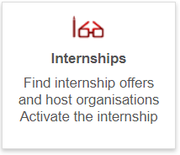

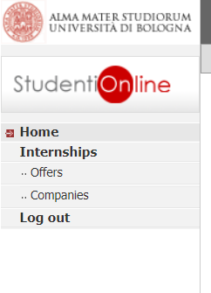
STEP 3a: Curricular External Internship
To check if the host organizations outside the University of Bologna are present in the Internships and Agreements application enter in the Studenti Online application, to access to the internship offers and companies.
If the host organization is present, students can proceed with their application following the online procedure.
If the host organization is not present, it is possible to open a new agreement with Unibo. Students have to contact the Internships Office of Ravenna Campus at least two months before the starting date of the internship in order to activate the agreement procedure.
Students can start with their internship only if the specific framework agreement between institutions is already established and only after applying for the approval of the training project through the online application for internships.
ALWAYS CHECK WITH YOU SUPERVISOR FIRST !!

Slide 8
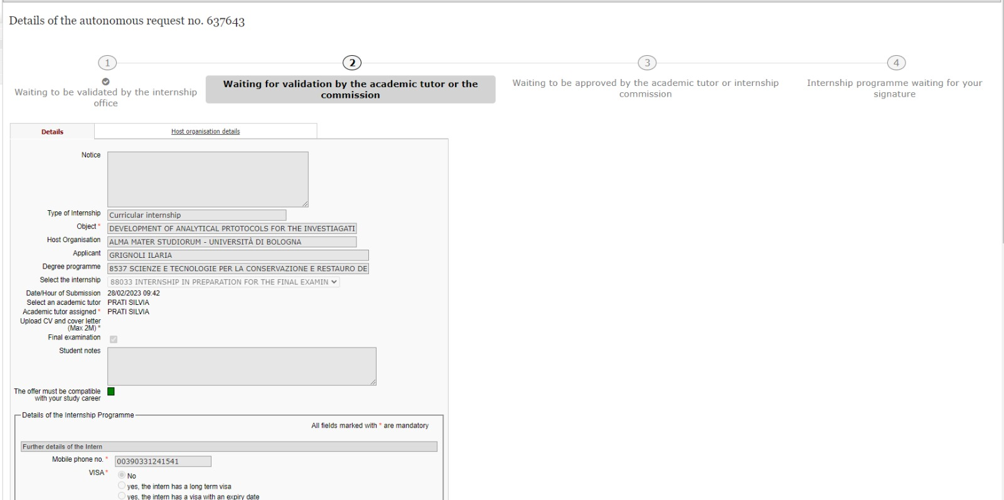
Example of procedure to open an internal internship
After you fill the request for the internship (details agreed with the supervisor) the request must be:
Validated by Ufficio Tirocini
Validated by your supervisor
3. Validated by the Internship Commision
4. Validated by YOU
Eventually you’ll download the attendance record and you can start!

Slide 9
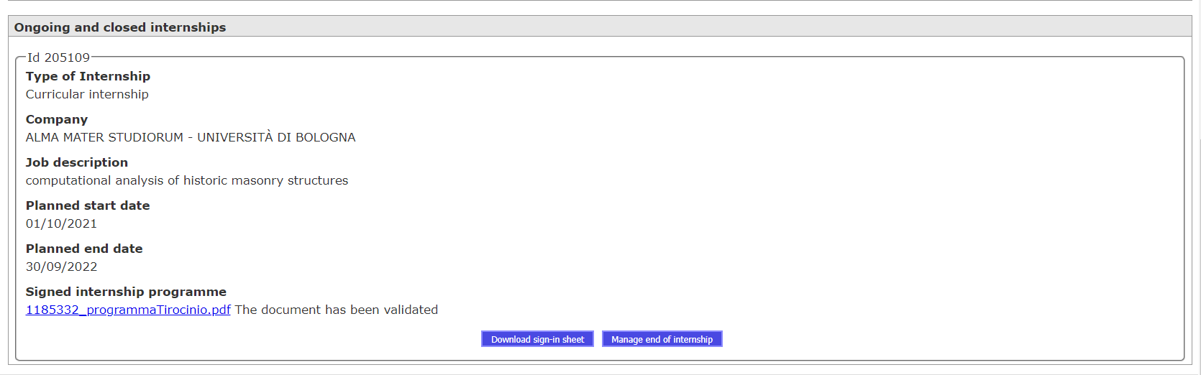
How to close the internship
At the end of your internship go to the internship application at Studenti online and find your ongoing internships:
Once you have the report and register prepared and signed, click here

Slide 10
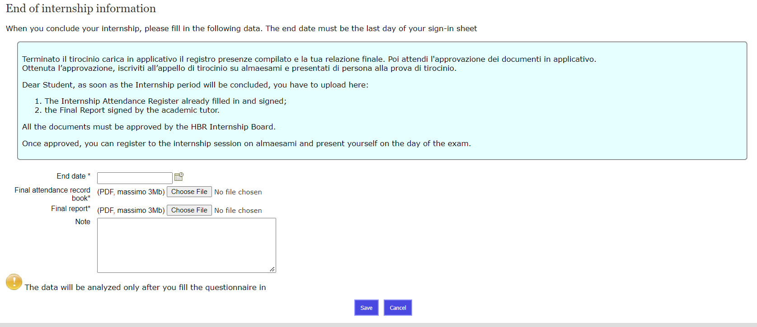
Once you select “Manage end of internship” this window will appear:
Enter the end date
Upload the signed register
Save all and complete the questionnaire that will appear once you saved

Slide 11
STEP 3: Opportunities for internships ABROAD
Erasmus+ mobility for traineeship (mainly EU countries + partners)
Call for applications published in March-May of your 1st year to leave during the 2nd year for Preparation of the final thesis abroad NOT RECOMMENDED for S.Co.Re students unless you have already agreed on the details of your thesis project with your chosen thesis Supervisor (host institution included) and have informed the Degree programme Director to obtain a proper pre-approval of the project.
Call for applications published in March-May of your 2nd year to leave as a recent graduate (or if you plan late graduation) RECOMMENDED for S.Co.Re students
Ciamician Scholarship → Highly recommended – best option!

Slide 12
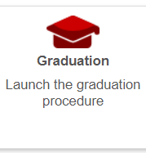
Step 3b: Step by step guide – Internship Abroad (Ciamician / Erasmus)
Find a host institution/laboratory where conduct your dissertation-oriented internship and a University of Bologna Professor who will be your Thesis Supervisor
Inform the Degree Programme Director to have your internship/mobility approved by the Degree Programme
Follow the relevant procedure to apply for the activation of the internship specifically outlined in the call
The thesis title, once agreed with the Supervisor, must be communicated to the Didactic Office (campusravenna.score@unibo.it) using the Thesis Title Module. This should be done at least 6 months before the date of the final dissertation.
Once the Thesis Title has been approved, the student can start with the application for admission to the final examination that must be submitted online on StudentiOnline
The validation of the credits is done on AlmaRM (you will find how to on the specific calls)

Slide 13
Step 3b: Fondazione Flaminia Scholarship
Highly recommended – best option (together with Ciamician)!
→ Every year few scholarships are offered to students enrolled into the 2nd year who intend to implement their experimental thesis abroad in host institutions/projects specifically designed for Score students - Last call for applications: Experimental thesis grants
BUT the bureaucratic procedure is the SAME as the internship without scholarship!
The registration of the CFU corresponding to the internship activity is done by closing the internship procedure and being signed by your supervisor and Master’s Director.

Slide 14

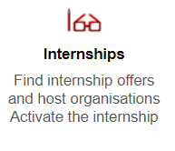

Internal/External Internship:
without any scholarship
external internship with Fondazione Flaminia scholarship
Internship with funds like Ciamician and Erasmus +:
Remember this difference as the whole procedure of the internship is consequently different!

Slide 15
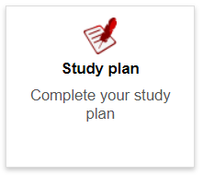
STEP 4: Study plan
2 time-frames to submit the study plan for the whole 2nd year on Studenti online
If you don’t have a course in your Study Plan you CANNOT take the exam
Once you have taken the exam and accepted the grade it CANNOT be changed anymore
You can follow the lessons even though you don’t have them in the study plan (exceptions related to trips/lab activities with insurance involved)

Slide 16
WHEN TO PRESENT YOUR STUDY PLAN
The online windows for the A.Y. 2025/26 are:
- First period: from September 1st to November 20th, 2025
E-mail Request to score@unibo.it for the Study Plan Committee approval: November 3rd, 2025 (Late requests will be processed for the second online window)
- Second period: from December 14th, 2025 to March 1st, 2026
E-mail Request to score@unibo.it for the Study Plan Committee approval: February 2nd, 2026 The mail request must be matched by the study plan submission on SOL, where the student will receive the formal approval by the Study Plan Committee.
If you need to modify the selection of thesis preparation abroad/in Italy after the second online window, due to an exceptional late change of the thesis project agreed with your thesis supervisor
→ send a motivated request to the Programme Coordinator score@unibo.it copying your thesis supervisor

Slide 17
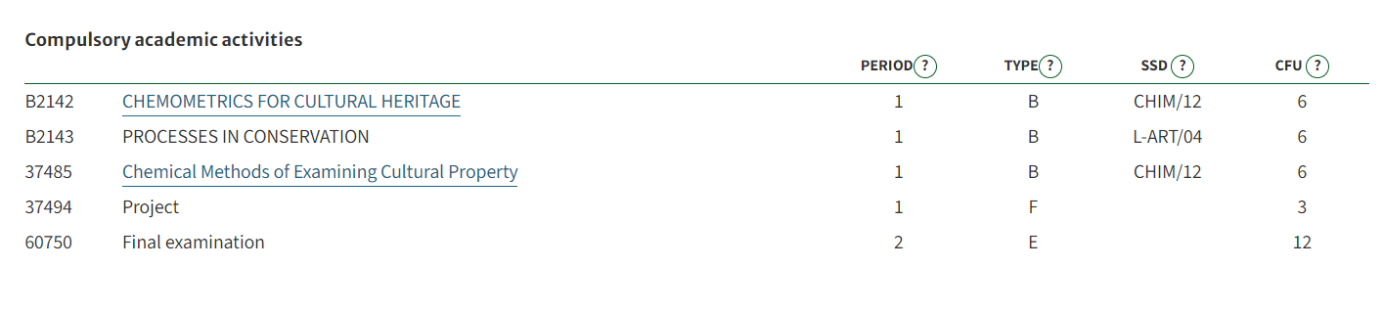
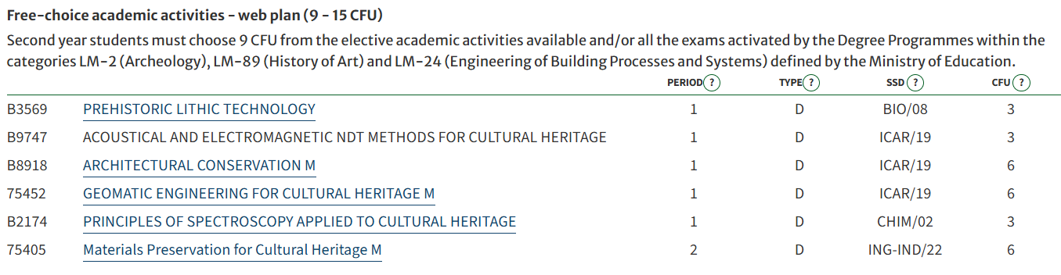
STEP 4: Study plan
You can choose from:
Suggested courses (preapproved by study board)
Any course from UNIBO: In this case, you will have to ask for the Study Plan Committee approval (specifying the code and name of the course unit you want to choose and the link to the course contents page)

Slide 18
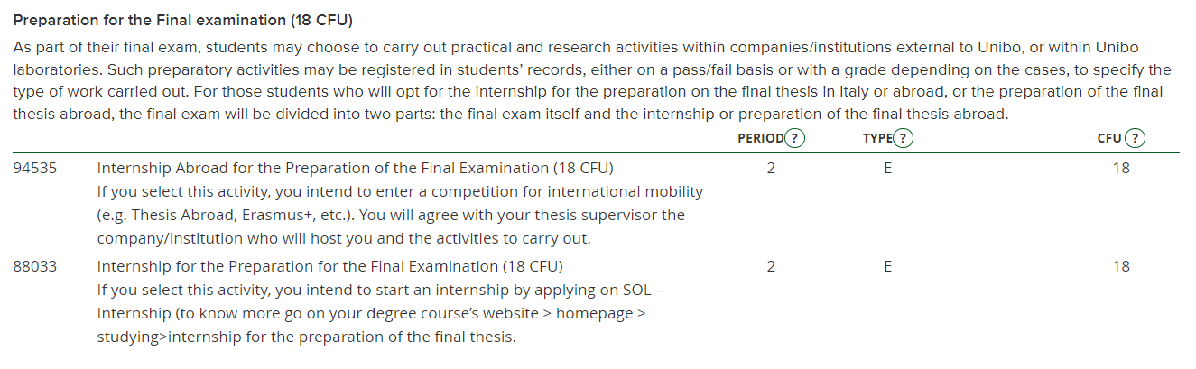
STEP 4: Study plan
Internal/External Internship without funds IN ITALY

Slide 19

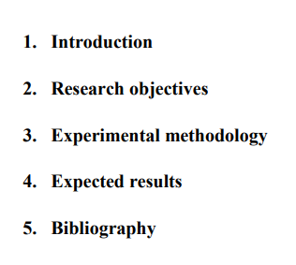
Project (3CFU)
THESIS PROJECT
THESIS PROJECT
THESIS PROJECT
PROJECT 3CFU
Graduating students, who already accomplished the obtainment of at least 50 credits (CFU) of S.Co.Re. degree programme, are allowed to prepare their thesis project to be submitted to prof. Silvia Prati in order to obtain the 3CFU.
More information are available here: https://corsi.unibo.it/2cycle/ScienceForConservation/how-to-prepare-the-thesis-project-3cfu
When should you do it? Around the beginning of the internship
What is this “thesis project”? It’s an elaboration on
what you’re going to do on your internship
THESIS PROJECT
You’re going to do 2 lessons with Professor Prati focused on it, do not worry!

Slide 20

Off topic: Postgraduation internship abroad
You can do an internship abroad after you graduate by applying for the Erasmus + mobility for traineeships: info Erasmus for Traineeship
The duration is 2 – 3 months, you can decide to prolong your stay but WITHOUT additional grant
You have to find a company by yourself ( the procedure is the same as if you were looking for a regular job). Below you can find an indicative list of companies that have already hosted SCoRe students for postgraduation internships in past
You MUST apply while you are still a student so before graduation and before the deadline of the specific call
List of companies and universities that have already hosted SCoRe students for postgraduation internships:
Name of the company / university | Erasmus code | Country
National Gallery Denmark (Statens Museum for Kunst), Centre for Art Technological Studies and Conservation (SMK-CATS) | BE 0055 | Danmark
Brandenburgisches Landsamt für Denkmalpflege und Archeologisches Landesmuseum | BE 0055 | Germany
Ghent University | B GENT01 | Belgium
Consorcio CENIEH | BE 0055 | Spain
Stiftung Preußischer Kulturbesitz | BE 0055 | Germany

Slide 21
Name of the company / university | Erasmus code | Country
National Museum in Krakow | BE 0055 | Poland
CSIC-EIM (Consejo Superior de Investigacioens Científicas) | BE 0055 | Spain
National Museum in Krakow | BE 0055 | Poland
Rijksdienst voor het Cultureel Erfgoed (Cultural Heritage Agency) | BE 0055 | Netherlands
Universite de Cergy-Pontoise | F CERGY07 | France
Centre national de la recherche scientifique (CNRS) | BE 0055 | France
Rathgen-Forschunglabor Staatliche Museen zu Berlin | BE 0055 | Germany
Consejo Superior de Investigaciones Científicas- CSIC | BE 0055 | Spain
Faculty of Fine Arts, Complutense University of Madrid | E MADRID03 | Spain
CNRS | BE 0055 | France
Hercules Laboratory from the Evora University | BE 0055 | Portugal

Slide 22
Last information! The call for the new tutor is about to be published!
100 hours tutorship
This role consists in:
Helping Students: The main job is to be a buddy to international and not only students, making sure they feel at home in a new country.
Being the interface between the student and the university: helping the students to sort out the paperwork, to answer their questions
Organization of Seminars, Open Day: together with the course coordinators
Supporting Struggling Students: For those students who hit a rough patch academically, you'll offer a helping hand with personalized support to get them back on track.
BOTH ENGLISH AND ITALIAN ARE REQUIRED

